Slide 1

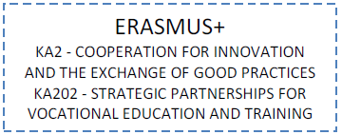
Intelligent Furniture
SMARTRAIN
Bridging pivotal competencies from VET curricula to co-creation in furniture design

Slide 2
Next steps
September | October | November | December | January | February | March | April | May | June | July | August | September
Partners meeting 1 Belgium
Students mobility in Woodwize
Online training for teachers | On-site validation of the learning material and updating with suggestions from validation
Students: Conception and Design of the furniture projects in AUTOCAD (students in their VET centres)
 |  |  |  | Online meeting. Plenary. | Online meeting. Plenary.
 |  |  |  | Students mobility in ENAIP / COSMOB | Students mobility in ENAIP / COSMOB
 |  |  | Online training for teachers / Learn & make a fitting or the Erasmus+ logo in 3D for their furniture | On-site validation of the learning material and updating with suggestions from validation
 |  |  |  | Students: Selection of materials and furniture mechanizing : Assembly and study of sensoring
 |  |  |  |  |  |  |  | Partners meeting 2 Spain
 |  |  |  |  |  |  |  | Students mobility in CIP FP Catarroja for application of sensoring and intelligence. | All partners: Evaluation of training material to i-VET and creation of methodology. Best practices with companies
 |  |  |  |  |  |  |  | Online training for teachers. | Final validation of material and methodology
 |  |  |  |  |  |  |  |  |  | National Multiplier Events Spain |  | Partner meeting 3 Italy
 |  |  |  |  |  |  |  |  | National Multiplier Events BE |  |  | National Multiplier Events IT

Slide 3
INDEX TRAINING UNIT FOR INTELLIGENT FOR SMART FURNITURE:
UNIT 1. Introduction to the concept of sensorised furniture. Digital furniture vs. intelligent furniture. Evolution.
UNIT 2. Type of intelligent furniture. Examples
UNIT 3. Main elements of a smart furniture and their characteristics: sensors, actuators, control system, power supply.
UNIT 4. Problems associated with the manufacture, sale and maintenance of this type of furniture. Possible solutions. Adaptation to the applicable regulations for electrical elements in furniture.
UNIT 5. Practical cases of sensor handling, programming, insertion in furniture,
UNIT 6. Related research/innovation projects illustrating the latest developments in the sector.

Slide 4
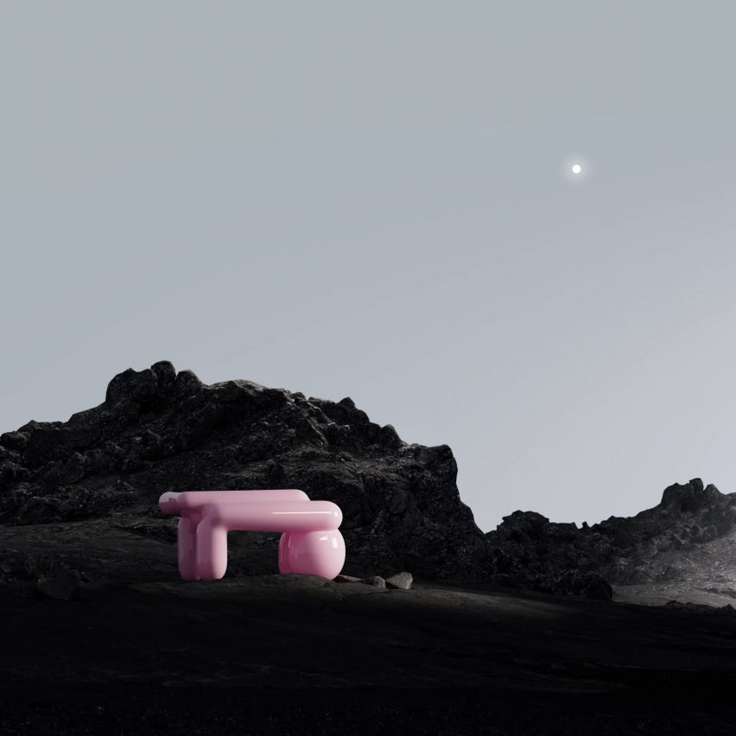
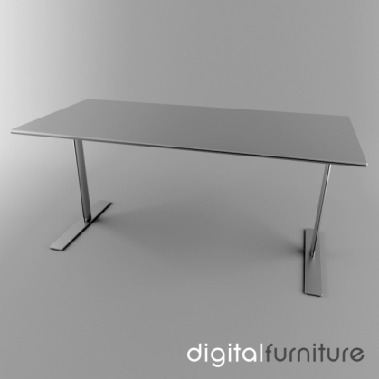
UNIT 1. INTRODUCTION TO THE CONCEPT OF SMART FURNITURE. DIGITAL FURNITURE VS. INTELLIGENT FURNITURE. EVOLUTION.
DIGITAL FURNITURE
Digital model of desk table avalaible in https://www.turbosquid.com
Deep Space sofa. Exists only digitally

Slide 6
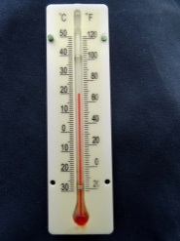
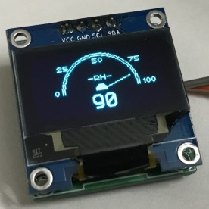

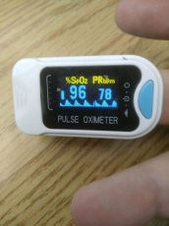
SOME CONSIDERATIONS:
For a piece of furniture to be considered "intelligent", it must not only integrate some kind of technology, but it must also meet two conditions:
It must be able to recognise environmental conditions. For example, it must be able to measure environmental conditions (temperature, humidity, sound, lighting, etc.), identify the user or his physiology, identify its location, etc.
It should be able to modify some of its characteristics to adapt to changes in the environment or communicate this change to the user for decision making. For example, it could automatically change the conditions of the environment (turn on/off lights, turn on the air conditioning, etc.), or it could automatically adapt to the height of the user if we were talking about a chair.

Slide 7
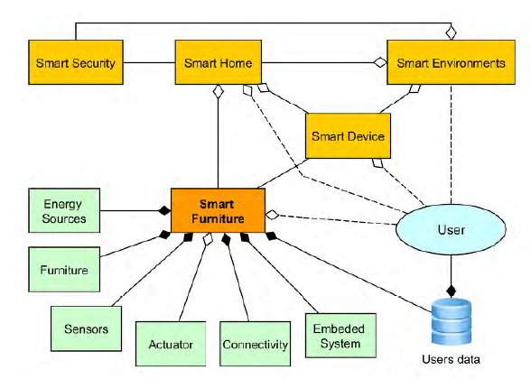
Smart Furniture as a Component of a Smart City—Definition Based on Key Technologies Specification. (Krejcar et al., 2019)
Smart Furniture is designed, networked furniture that is equipped with an intelligent system or controller operated with the user's data and energy sources. Smart Furniture is able to communicate and anticipate the user's needs using a plurality of sensors and actuators inside the user's environment, resulting in a form of user-adapted furniture or an environment that satisfies the user-declared needs and non- declared needs for the purpose of improving their quality of life in a smart world.

Slide 8
Several studies mention that the most important characteristics for a Smart Furniture are :
(1) Design
(2) Functionality
(3) Safety in Use
(4) Customization
(5) Structural Design

Slide 9
LEVELS OF INTELLIGENCE
      MECHANICAL INTELLIGENCE
Mechanical intelligence is that the mechatronic device composed of various parts is implanted in the body of the furniture and the mechanical structure or transmission mechanism is operated through a certain manual control. Through a simple touch, light press and other actions, the user can initiate the automatic opening or closing of the furniture cabinet or drawer and automatic lifting, rotation, expansion and other functions of the desktop.
      ELECTRONIC INTELLIGENCE
Electronic intelligence is the combination of advanced and cutting-edge electronic technology products and traditional furniture through wired or wireless electronic remote control or touch control to realize the intelligent functions of furniture. The user only needs a simple touch action to control the automatic operation of the furniture through an induction device, and realize the adjustment of various functional parameters. Such as playing audio and video, turning LED lights on and off or adjusting the brightness of the light.
      IOT INTELLIGENCE
IOT Intelligence IOT (Internet of Things) intelligence is to implant advanced intelligent systems or intelligent components (sensors, embedded systems, etc.) into the furniture body and connect intelligent hardware, APP software and data platforms through the network,.

Slide 10
SMART MATERIALS CONCEPT
We are currently witnessing the continuous emergence of innovative materials that have greater or lesser application in the furniture industry.
The main reasons driving this continuous innovation are:
1.- Need to differentiate with the technology of less developed countries: application of new technologies, such as telecommunications, nanotechnology, active materials, ...
2.- Social pressure to find materials and processes more respectful with the environment and from renewable sources: "Green procurement" and specifications of public administrations are increasingly requesting this type of materials. Circular economy
3.- Products and materials that preserve the safety and comfort of the user: fire safety, need for clean air in the home, comfort, ...
4.- Need for a better use and energy efficiency.
5.- Materials and products that adapt to the growing mobility of the user and to the size of the homes.
6.- Demographic curve tending to an aging population: mobility problems, vision problems, etc.. and the need to lead an independent life.

Slide 11
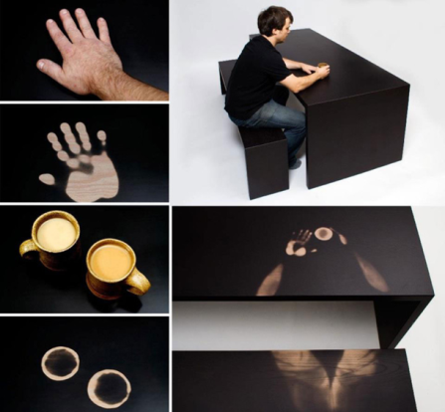



    TYPES OF SMART MATERIALS
Smart materials and systems are divided into two classes :
1. Materials undergo changes in one or more of their properties (chemical, electrical, magnetic, mechanical, or thermal) in direct response to a change in external stimuli in the surrounding environment. The energy input to a material affects the internal energy of the material by altering the material’s microstructure and the input results in a property change of the material.
2. Smart materials that transforms energy from one form to another. The energy input to a material changes the energy state of the material composition, but does not alter the material, it stays the same, but the energy undergoes a change.

Slide 12
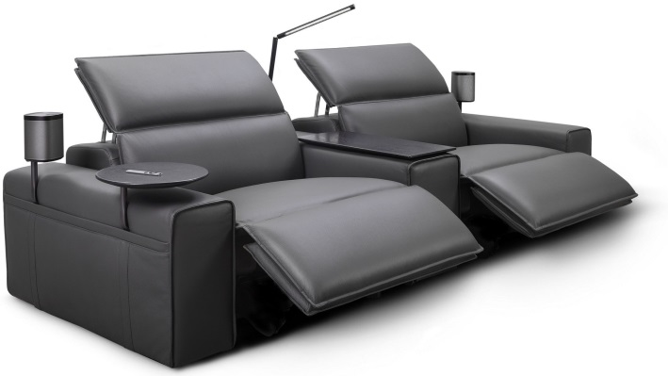
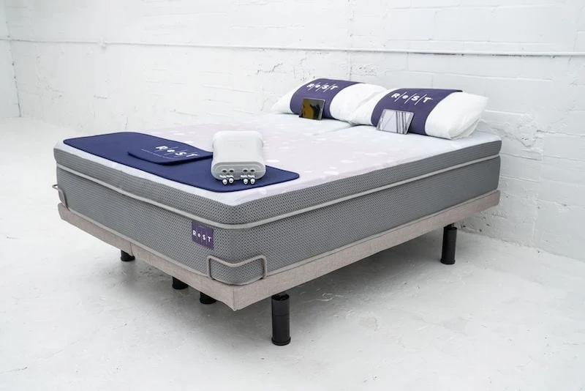

UNIT 2. SOME EXAMPLES
https://www.kingliving.com.au/king-difference/technology-and-innovation
Smart Sofa. King Cloud III sofa.
Intelligent mattress by Rest Bed
https://restperformance.com/

Slide 13
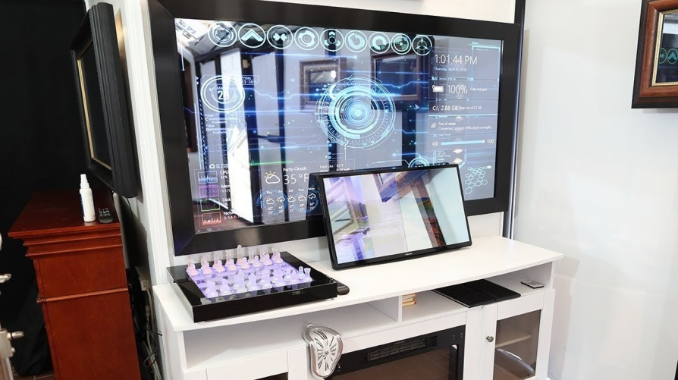

https://www.twowaymirrors.com/diy-smart-mirror/

Slide 14
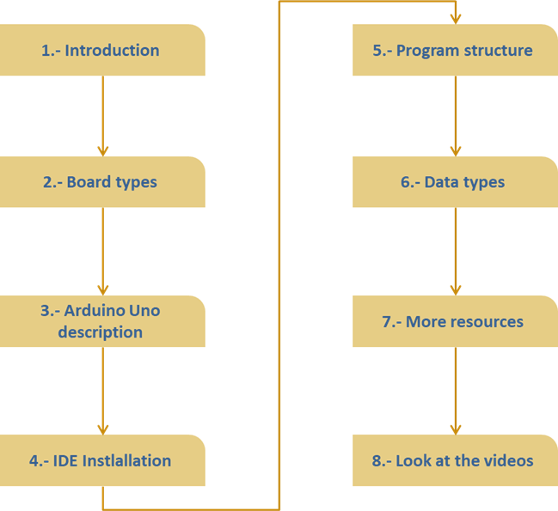
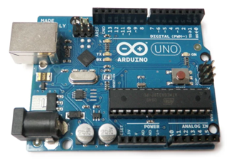
UNIT 3. Main elements of a smart furniture and their characteristics: sensors, actuators, control system, power supply.
INTRODUCTION TO ARDUINO BOARD
Arduino is an open-source electronics platform based on easy-to-use hardware and software. Arduino boards are able to read inputs - light on a sensor, a finger on a button, or a Twitter message - and turn it into an output - activating a motor, turning on an LED, publishing something online

Slide 15
SENSORS, ACTUATORS, CONTROL SYSTEM, POWER SUPPLY
General sensor characteristics
Definition: A sensor is an electrical and/or mechanical device that converts physical quantities (light, magnetism, pressure, etc.) into measurable values of that quantity.
This may be done in three stages:
1. A physical phenomenon to be measured is captured by a sensor, and it displays at its output an electrical signal dependent on the value of the physical variable.
2. The electrical signal is modified by a signal conditioning system, the output of which is a voltage.
3. The sensor has an electronic circuit that transforms and/or amplifies the output voltage, which is passed to an A/D converter connected to a PC. The A/D converter transforms the DC voltage signal into a discrete signal.

Slide 16
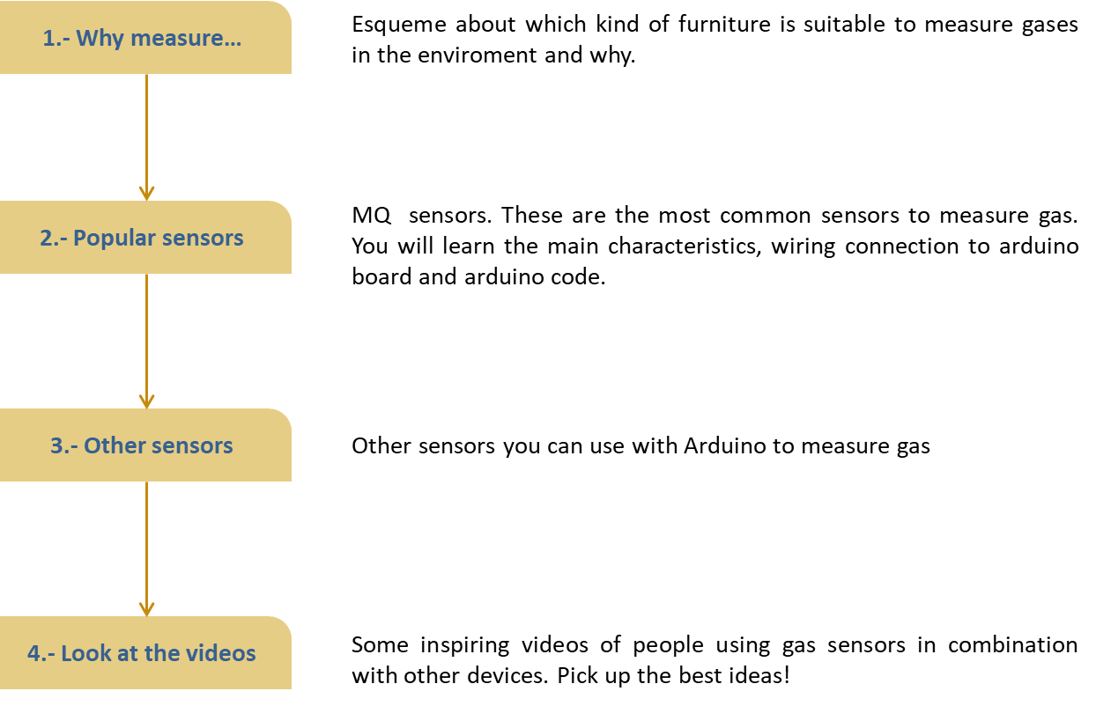
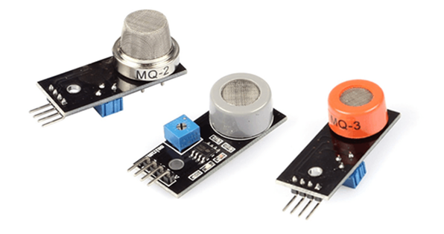
GAS SENSORS
https://youtu.be/AFqmaL0Rsjw
https://youtu.be/nmI8rlmCUng

Slide 17
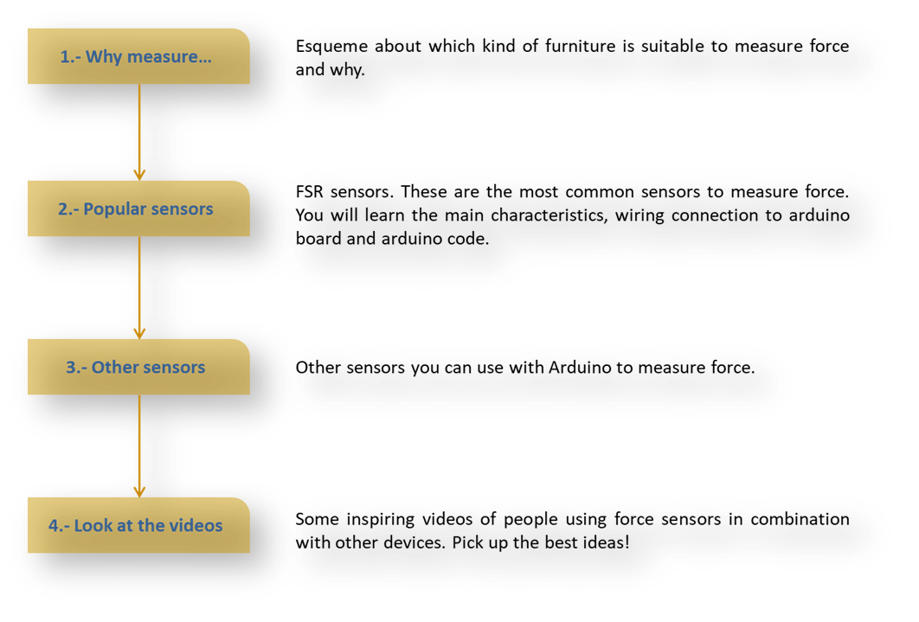
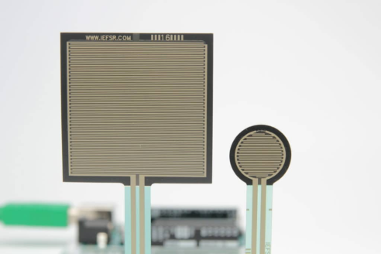
FORCE SENSORS
https://www.makerguides.com/fsr-arduino-tutorial/
https://www.youtube.com/watch?v=3Ahrr2SNVZM

Slide 18
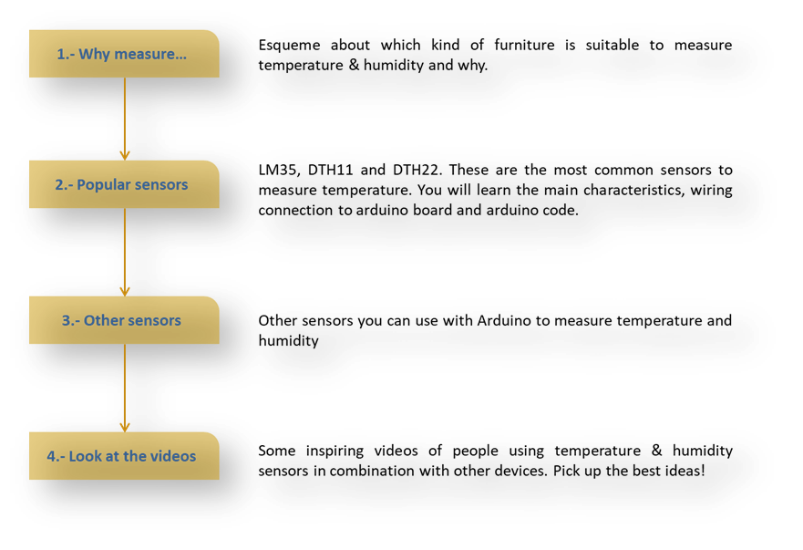
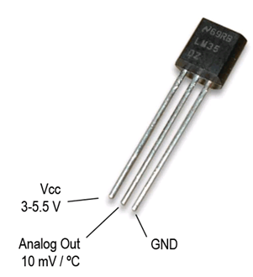
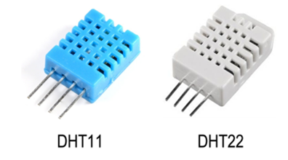
  Humidity and Temperature sensors

Slide 19
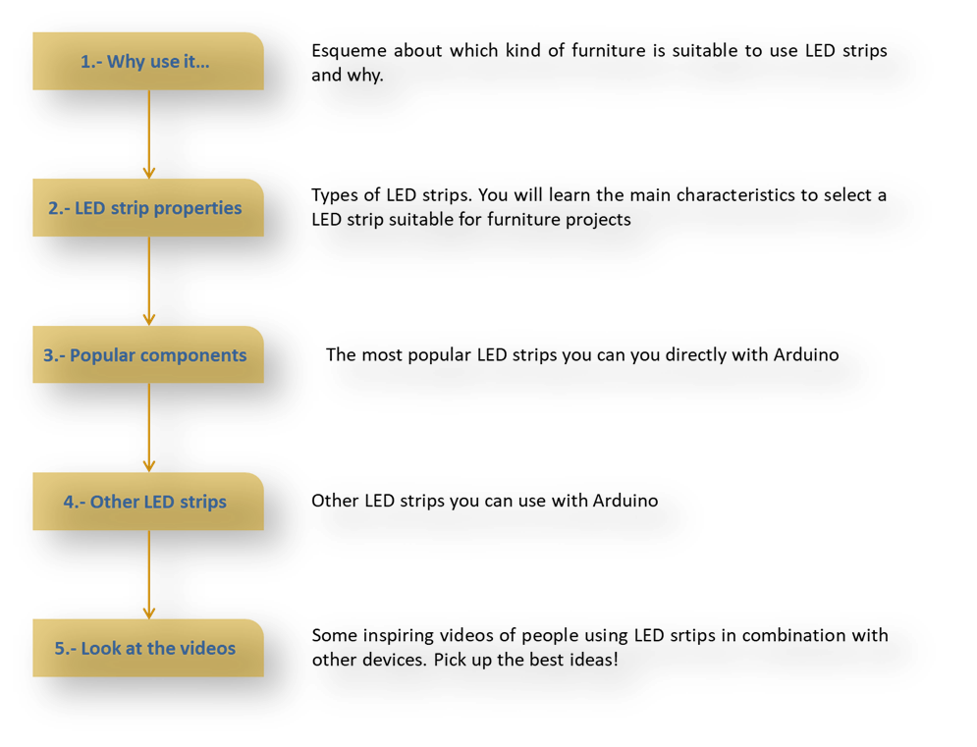
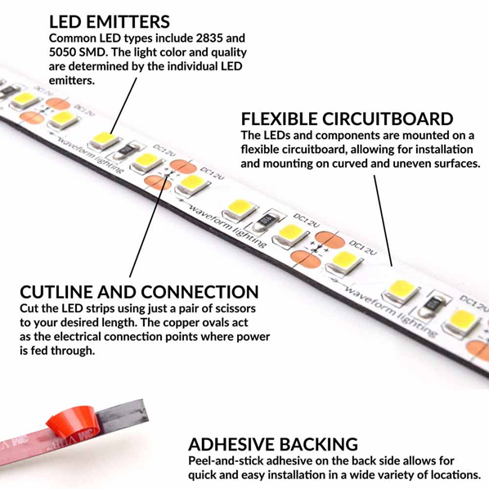
LED STRIPS
www.youtube.com/watch?v=NHkju5ncC4Aueble

Slide 20
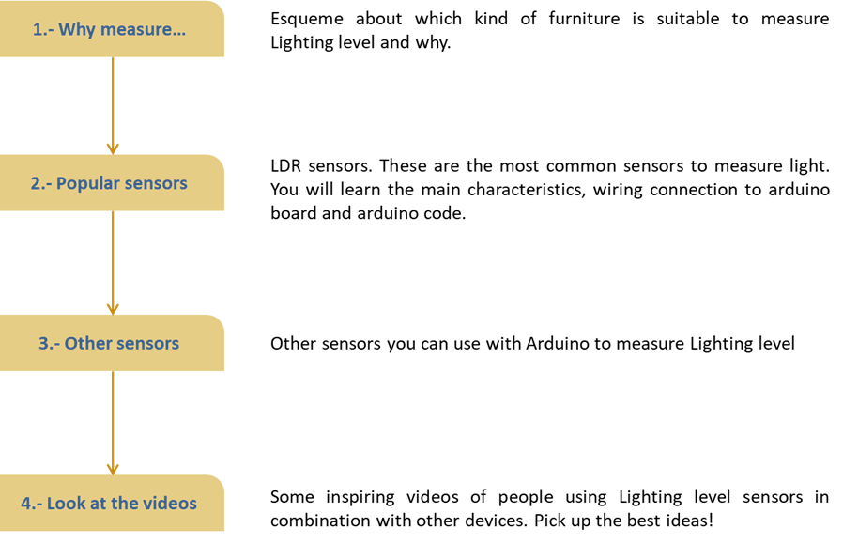
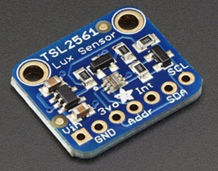
  Measuring Lighting level

Slide 21
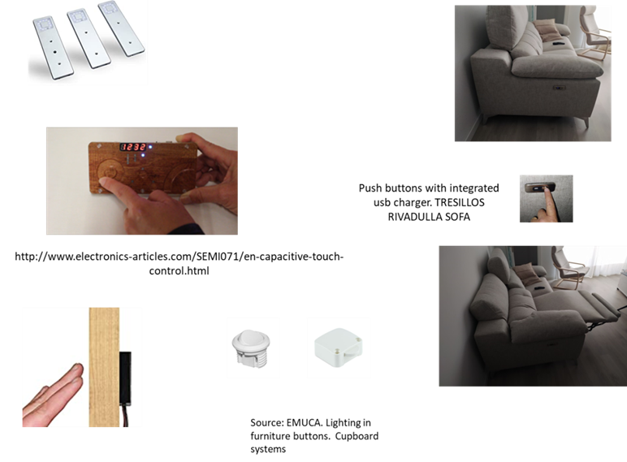
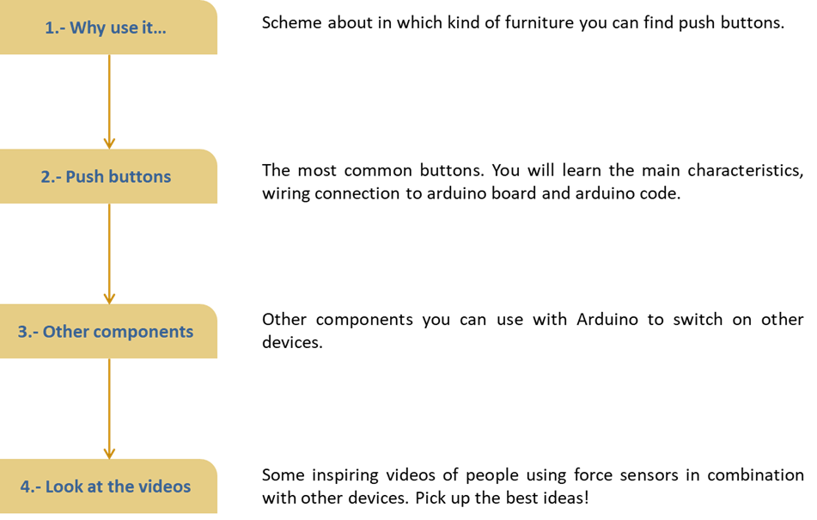
USING PUSH BUTTONS

Slide 22
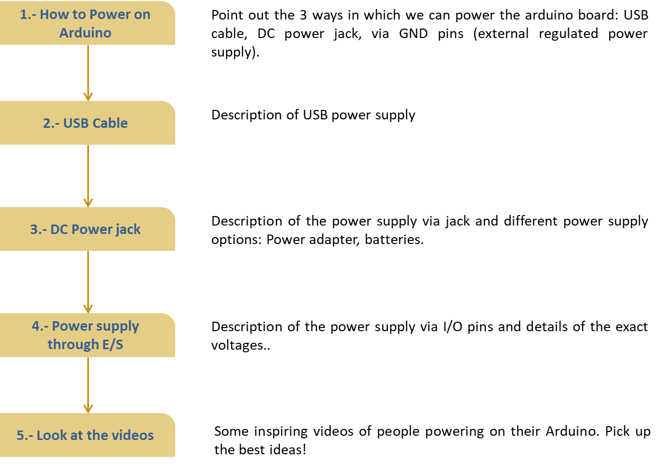
POWER SUPPLY

Slide 23
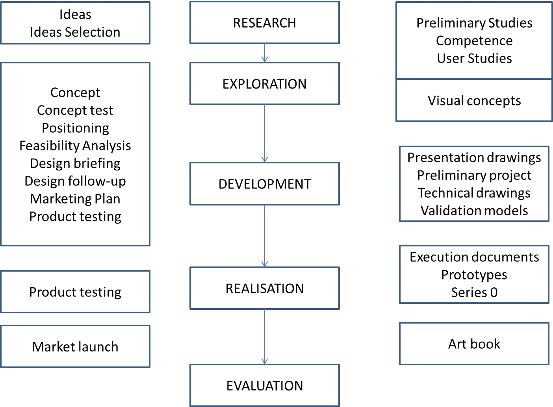
Development of a piece of furniture from scratch
UNIT 4. Problems associated with the manufacture, sale and maintenance of this type of furniture. Possible solutions. Adaptation to the applicable regulations for electrical elements in furniture.

Slide 24
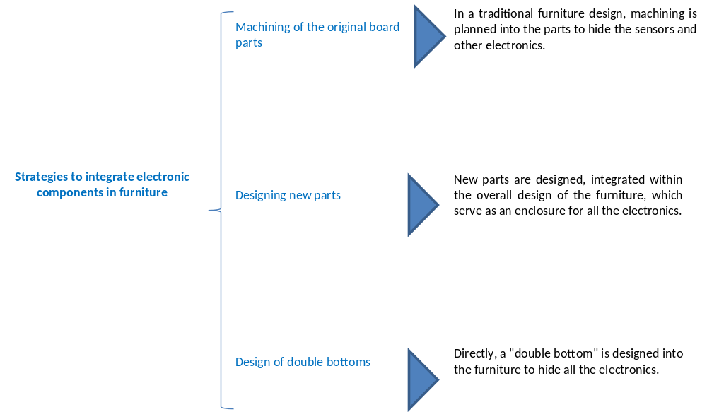
Integration in furniture

Slide 25
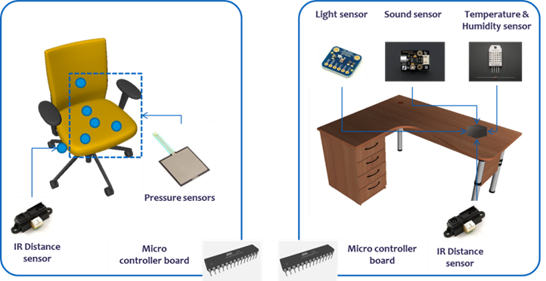
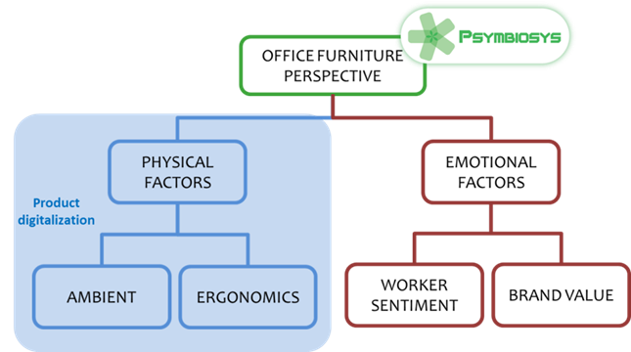
UNIT 5. Practical cases of sensor handling, programming, insertion in furniture
In this unit some basic knowledge of networks, programming languages, and cloud platforms will be introduced. With that ground knowledge, we will be able to adapt these tools to our problem of developing and improving smart furniture.
UNIT 6. Related research/innovation projects illustrating the latest developments in the sector.
PSYMBIOSIS PROJECT

Slide 26
WORK PLAN
October | November | December | January | February | March | April | May | June | July | August | September
Partners meeting 1 Belgium
Students mobility in Woodwize
On-site validation of the learning material and updating with suggestions from validation
Students: Conception and Design of the furniture projects in AUTOCAD (students in their VET centres)
 |  |  |  | Online meeting. Plenary.
 |  |  |  | Students mobility in ENAIP / COSMOB
 |  | Online training for teachers / Learn & make a fitting or the Erasmus+ logo in 3D for their furniture | On-site validation of the learning material and updating with suggestions from validation
 |  |  | Students: Selection of materials and furniture mechanizing : Assembly and study of sensoring
 |  |  |  |  |  |  | Partners meeting 2 Spain
 |  |  |  |  |  |  | Students mobility in CIP FP Catarroja for application of sensoring and intelligence. | All partners: Evaluation of training material to i-VET and creation of methodology. Best practices with companies
 |  |  |  |  |  |  | Online training for teachers. | Final validation of material and methodology
 |  |  |  |  |  |  |  |  | National Multiplier Events Spain |  | Partner meeting 3 Italy
 |  |  |  |  |  |  |  | National Multiplier Events BE |  |  | National Multiplier Events IT

