Slide 1
SMARTRAIN
Using LED strips

Slide 2
INDEX
1.- Why use it…
Esqueme about which kind of furniture is suitable to use LED strips and why.
2.- LED strip properties
Types of LED strips. You will learn the main characteristics to select a LED strip suitable for furniture projects
3.- Popular components
The most popular LED strips you can you directly with Arduino
4.- Other LED strips
Other LED strips you can use with Arduino
5.- Look at the videos
Some inspiring videos of people using LED srtips in combination with other devices. Pick up the best ideas!

Slide 3
1.- WHY USE LED STRIPS
Lights integrated in
smart home concept https://youtu.be/VfU2kjZ-1ZA
Smart Home
Lighst with sensors: https://youtu.be/SGtHlr0v6Vc
Senior people and security in general
Luces led para escaleras con sensor de presencia. www.youtube.com/watch?v=NHkju5ncC4Aueble
Home
LAMPARA NOBI: https://www.youtube.com/watch?v=_lapF6eiWzo
LED in drawers: https://www.youtube.com/watch?v=KAWUHjDPpmc
Led in doors
https://www.youtube.com/watch?v=HLotyf6hMLU
General use
Led for different aplications. HAFELE
https://youtu.be/y3ToQpokyU4
Entertaiment
GAMING: https://youtu.be/mq6iy6kDDFU
Lighting management
In the office
Office
Ergonomy and wellbeing at work
https://www.youtube.com/watch?v=HIM4XyQgp3g
Leisure/Culture
Outer benches https://youtu.be/b3GYxawD19w
Outdoor
General use
Furniture for outdoor. Lounges, etc…https://www.youtube.com/watch?v=4-6_h-8MeA0

Slide 4
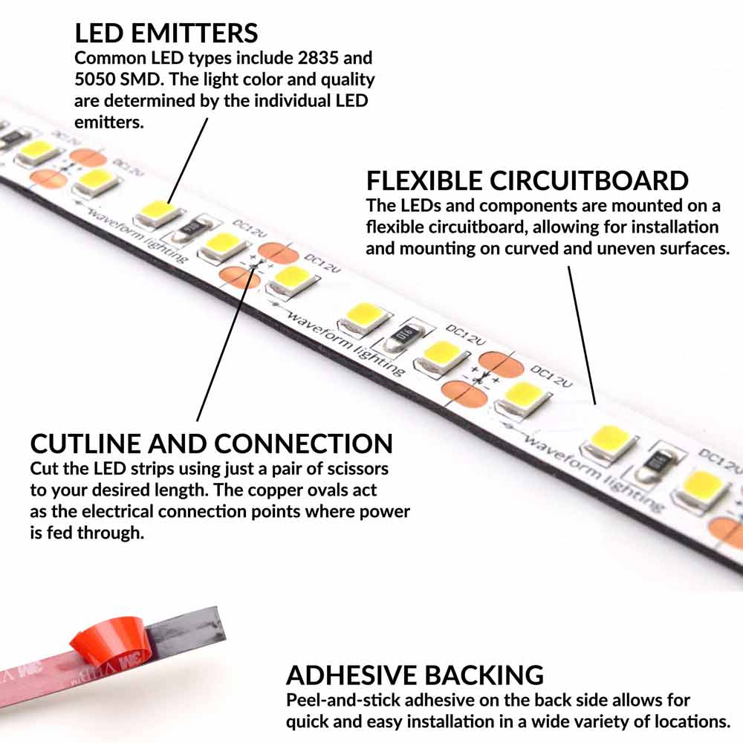
2.- LED STRIPS PROPERTIES
Component description
A LED strip light is typically half an inch (10-12 mm) in width, and up to 16 feet (5 meters) or more in length. They can be cut to specific lengths using just a pair of scissors along the cutlines, located every 1-2 inches.
Individual LEDs are mounted along the strip. The light color and quality of the individual LEDs determine the overall light color and quality of the LED strip.
The backside of the LED strip includes pre-applied double-sided adhesive. Simply peel off the liner, and mount the LED strip to virtually any surface. Because the circuitboard is designed to be flexible, LED strips can be mounted on curved and uneven surfaces.
Source: https://www.waveformlighting.com/led-strip-lights

Slide 5
2.- LED STRIPS PROPERTIES
No water protection
1) IP protection
Water protection
2) Chip
3) Length
30 led/m
4) Density
60 led/m
LED strips
120 led/m
5) Brightness
➔ Lumens
Fixed
6) Color
Variable ➔ RGB
7) Color temperature
➔ K
AC
8) Power supply
DC: 5V, 12V, 24V

Slide 6
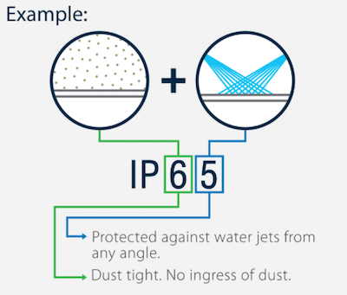
2.- LED STRIPS PROPERTIES
1) IP protection
IP is an acronym "Ingress Protection". It is a measurement of the protection an item will have against solid objects (dust, sand, dirt, etc.) and liquids.
An IP rating is comprised of 2 numbers. The first number refers to the protection against solid objects (dust, etc) and the second number refers to protection against liquids.
Source: https://www.flexfireleds.com/

Slide 7
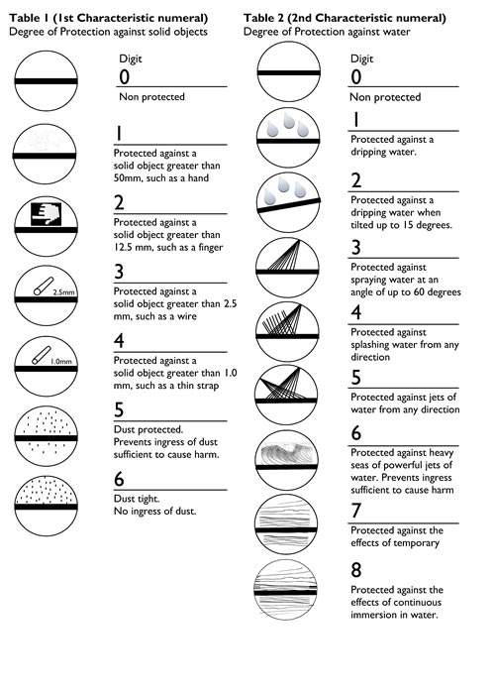
2.- LED STRIPS PROPERTIES
1) IP protection
Each IP rating has two numbers, both of which give you information about the protection level. A higher number means greater protection against solids and liquids.
- The first number (0-6) refers to the level of protection against solid objects and moving parts, such as dust, debris, or other solid matter.
- The second number (0-8) references the level of liquid and moisture protection.
Source: http://blog.flexfireleds.com/

Slide 8
2.- LED STRIPS PROPERTIES
1) IP protection
IP20/IP33 - Not waterproof. This is standard uncoated strip. Use in dry and dust free areas such as ceiling coves, display cabinets, wall washers, bedroom and living rooms (indoor).
IP65 – Splash resistant. The PCB, LEDs and other components on the top of the strip are coated with silicone, providing protection against dust and splashing water. Typical interior uses are in bathrooms or kitchens, under cabinets and in places where there is a chance that people will have contact with the strip. The cable and driver used when installing an IP65 strip must have an IP65 rating.
IP67 - Water resistant. This strip is protected with a silicone gel against temporary immersion in water between 15cm and 1 meter. Excellent protection for indoor and outdoor use. Typical interior uses include bathrooms or kitchens, under cabinets and near showers or sinks. Typical outdoor uses include pathways or walls. In addition to the self-adhesive tape; Integral LED IP67 strips are supplied with mounting clips to secure the strip. IP67 strips should NOT be continuously immersed in water. The cable and driver used during installation must also have an IP67 rating

Slide 9
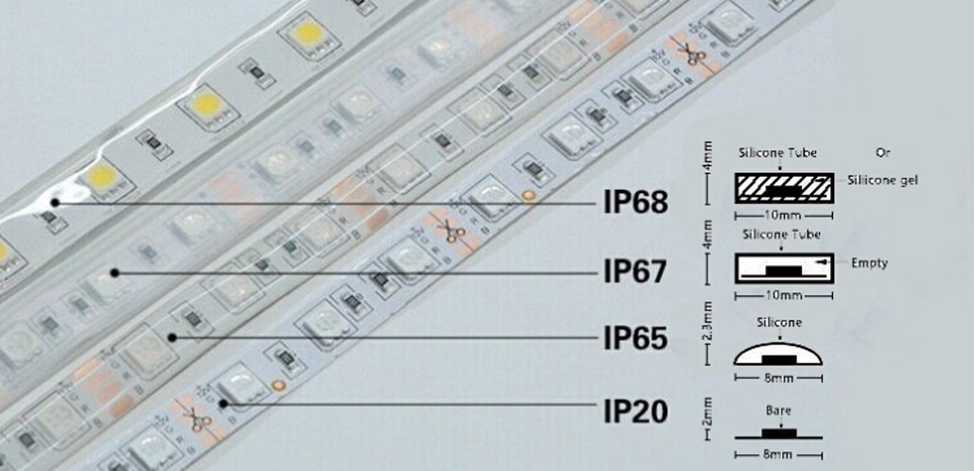
2.- LED STRIPS PROPERTIES
1) IP protection
Here you can see the difference between several IP protection in a LED
Source: https://www.easeking.com/

Slide 10
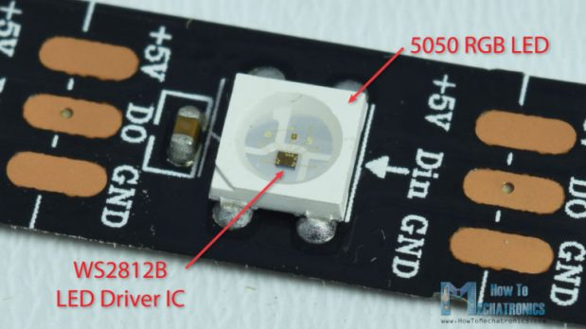
2.- LED STRIPS PROPERTIES
2) Chip
A LED strip description often includes a 4-digit number such as 5050 or 2835. The number usually describes the size of the chip.
For example, a 5050 LED chip measures 5.0 mm wide by 5.0 mm tall. Similarly, a 2835 chip measures 2.8 mm wide by 3.5 mm tall.
If you are looking at a digitally addressable strip, you will likely see a four digit number (for example, WS2812B or SK6812). But in this case, it has nothing to do with chip size. Instead, the number is the name of the integrated LED controller chip.
Source: https://thesmartcave.com/led-strips-guide/

Slide 11
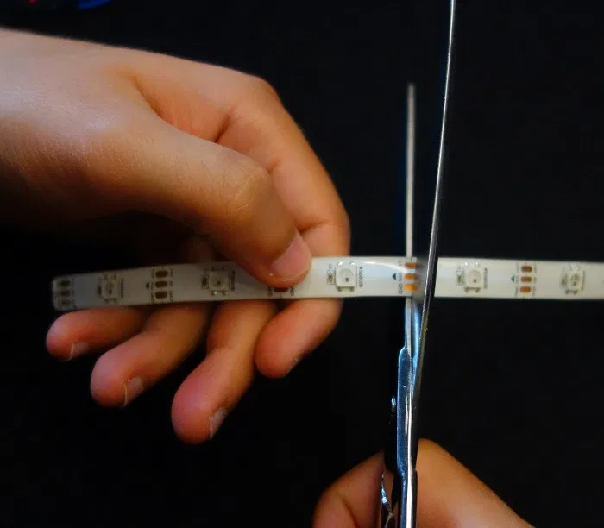
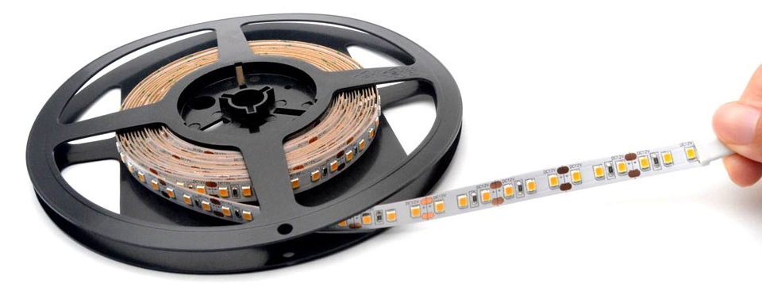
2.- LED STRIPS PROPERTIES
3) Length
Usually, LED strips come on reels with several meters long and can be cut into small segments.
There are cutting marks along the strip marked with a scissors icon that shows you where you can cut your strip as shown in the figure below. This strip has segments of three LEDs.
Source: https://www.waveformlighting.com/led-strip-lights
Source: https://randomnerdtutorials.com/best-led-strip-for-your-project/

Slide 12
2.- LED STRIPS PROPERTIES
4) Density
LED density is important in determining the distance between LEDs (pitch) and whether or not there will be visible hotspots and dark spots between the LED emitters. A higher density of 36 LEDs per foot (120 LEDs per meter) will typically provide the best, most evenly distributed lighting effect. LED emitters are the most expensive component of LED strip manufacturing, so be sure to account for LED density differences when comparing LED strip prices.
Next, consider an LED strip light's power draw per foot. The power draw tells us the amount of power the system will consume, so this is important to determine your electricity costs and power supply requirements. A good quality LED strip should be capable of providing 4 watts per foot or more (15 W/meter).
Finally, do a quick check to determine if the individual LEDs are being overdriven by dividing the wattage per foot by the LED density per foot. For an LED strip product, it is usually a good sign if the LEDs are not driven at more than 0.2 watts each.

Slide 13
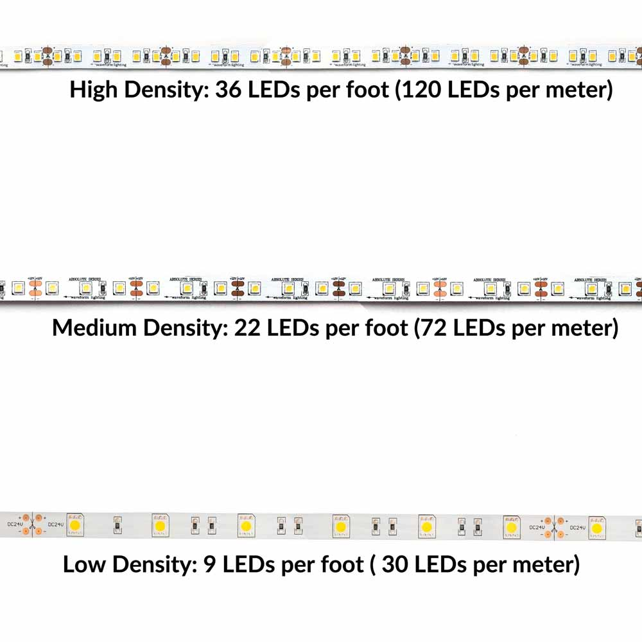
2.- LED STRIPS PROPERTIES
4) Density
Source: https://www.waveformlighting.com/led-strip-lights

Slide 14
2.- LED STRIPS PROPERTIES
5) Brightness
Brightness of LEDs is measured in lumens. Depending on how you are using the LED strips, you will probably want a certain level of lumens. For accent lighting you will probably not want anything brighter than 200 Lumens per foot but for other applications where you want more light it just depends on your personal preference of how bright you want them. So, make sure you take note of the Lumens/length along with the LEDs/length as this will have a strong effect on light quality and the type of light the strip gives off.
Every type of led chip has its own brightness. As an example:
- SMD3528 (3.5mm x 2.8mm): Each LED emits 3 to 5 lumens
- SMD5050 (5.0mm x 5.0mm): Each LED emits 10 to 15 lumens

Slide 15
2.- LED STRIPS PROPERTIES
5) Brightness
The level of Brightness and power consumption is variable according the density. Here you can see some data:
- 60 SMD3528 LEDs per metre (From 180 to 300 lumens per metre)
- 120 SMD3528 LEDs per metre (From 360 to 600 lumens per metre)
- 60 SMD5050 LEDs per metre (From 600 to 900 lumens per metre)
- 72 SMD5050 LEDs per metre (From 720 to 1,080 lumens per metre)
- 120 SMD5050 LEDs per metre (From 1,200 to 1,800 lumens per metre)
- 60 SMD3528 LEDs per metre - 5 W per metre of strip.
- 120 SMD3528 LEDs per metre - 9 W per metre of strip.
- 60 SMD5050 LEDs per metre - 14.4 W per metre of strip.
- 72 SMD5050 LEDs per metre - 17.3 W per metre of strip.
- 120 SMD5050 LEDs per metre - 28.8 W per metre of strip

Slide 16
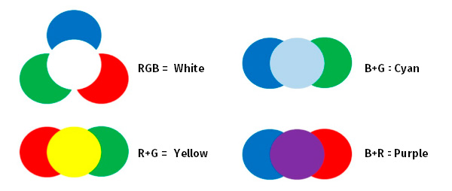
2.- LED STRIPS PROPERTIES
6) Color
LED strip lights come in a wide range of single colors as well as multi-color strips. The most basic LED strip lights are single colors that only emit one fixed light color.
RGB – Red, Green, Blue
An RGB LED contains three diodes (LED stands for Light Emitting Diode) on the same chip: one for each color. Each color is wired to its own channel. By adjusting the power delivered to each color (using a controller), any combination of colors can be created.
Source: https://greenice.com/en/content/56-basic-concepts-of-led-strips

Slide 17
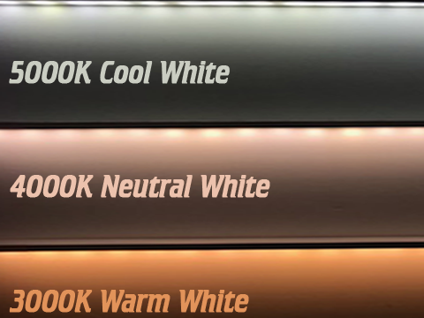
2.- LED STRIPS PROPERTIES
7) Color Temperature
Color temperature is how we differentiate the various white colors that an LED can produce. Temperature indicates how ‘warm’ or ‘cool’ the light appears. Temperature is measured in Kelvin with higher temps representing cool colors (blueish hue) and lower temps representing warmer colors (yellowish light you would expect from a bulb).
W – White. Typically a single “W” refers to a pure white (4000K). There’s no set standard so make sure to double check.
WW – Warm White. Warm white is usually 3000K, similar to the color of an incandescent bulb.
CW – Cold (or cool) White. Cold white is in the 5000K range.
Source: https://www.ledsupply.com/blog/ultimate-guide-on-buying-led-strip-lights/

Slide 18
2.- LED STRIPS PROPERTIES
8) Power supply
Inside the LED strips we can find 4 voltage ranges that we will consider how the main ones. These are: 5VDC, 12 VDC, 24 VDC and 220 VAC.
- 5 VDC LED Strips: Within this section we can encompass the strips that have direct connection to a USB port and some digital strips. Are not the most common we can find in the market, although it is well to quote them for the user Know.
- 12/24 VDC LED Strips: As for the advantages that we offer this type of strips is that can be cut every 5 cm in 12 VDC and 10 cm in 24 VDC. With this type of strips, more precise installations can be made than with the strips of direct connection to network. In addition, the Working in low voltage ranges, handling them is simpler and less dangerous. The main drawback of working with this type of strips is the length of the facilities. It is recommend not to make installations of more than 10 meters so as not to have voltage drops and therefore loss of Lighting. In addition, it is necessary to install a transformer that converts the current that pours the mains power to the working voltage of the strips. This condition is a handicap in some facilities where a transformer cannot be installed.

Slide 19
2.- LED STRIPS PROPERTIES
8) Power supply
- 220 VAC LED Strips: This type of strips is a "modified" version of the 12/24 VDC strips so that they can be connected directly to the mains by means of an outlet. The main advantage, is that these LED strips are connected directly to the power grid so that we save the so annoying transformer. In addition, with this type of strips the problem of the voltage drop does not exist so that we can make installations of 50 meters linear without any problem. As for the drawbacks, we can find that with this type of strips cannot make more precise installations because you can only make cuts every meter, so the facilities have to be multiples of 1 meter. Also, when working in a high voltage range, it is necessary to be more cautious in its installation and handling.

Slide 20
3.- POPULAR COMPONENTS
1) Neo Pixel. Description
“NeoPixel” is Adafruit’s brand for individually-addressable RGB color pixels and strips based on the WS2812, WS2811 and SK6812 LED/drivers, using a single-wire control protocol. NeoPixels don’t just light up on their own; they require a microcontroller (such as Arduino) and some programming.
NeoPixel Digital RGB LED Weatherproof Strip is available in three different “densities”: 30, 60 and 144 LEDs per meter, on a white or black backing strip.
  30 LEDs per meter,
  60 LEDs per meter,
  144 LEDs per meter,
The approximate peak power use (all LEDs on at maximum brightness) per meter is:
  30 LEDs: 9 Watts (about 1.8 Amps at 5 Volts).
  60 LEDs: 18 Watts (about 3.6 Amps at 5 Volts).
  144 LEDs : 43 watts (8.6 Amps at 5 Volts).
Mixed colors and lower brightness settings will use proportionally less power.

Slide 21
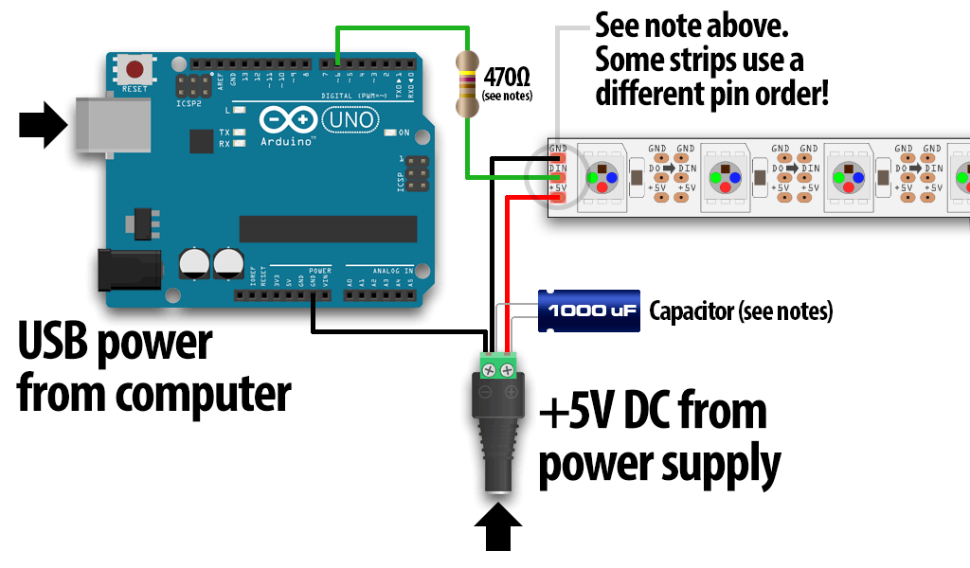
3.- POPULAR COMPONENTS
1) Neo Pixel. Wiring
Source: https://www.adafruit.com

Slide 22
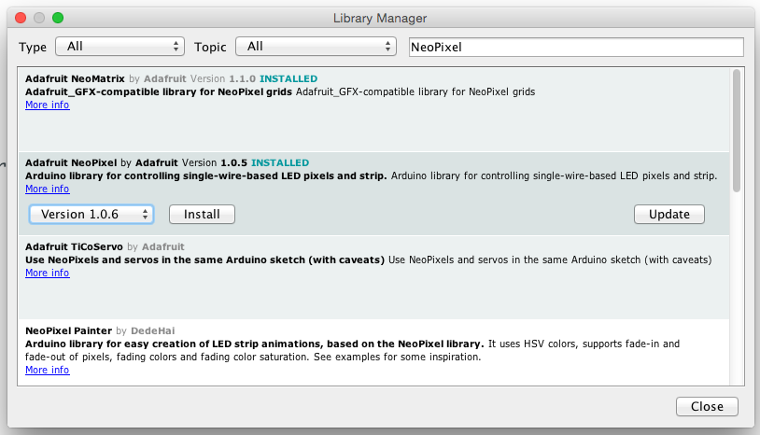
3.- POPULAR COMPONENTS
1) Neo Pixel. Code
Recent versions of the Arduino IDE (1.6.2 and later) make library installation super easy via the Library Manager interface. From the Sketch menu, > Include Library > Manage Libraries... In the text input box type in "NeoPixel". Look for "Adafruit NeoPixel by Adafruit" and select the latest version by clicking on the popup menu next to the Install button. Then click on the Install button. After it's installed, you can click the "close" button.
Source: https://www.adafruit.com

Slide 23
3.- POPULAR COMPONENTS
1) Neo Pixel. Code
Launch the Arduino IDE. From the File menu, select Sketchbook→Libraries→Adafruit_NeoPixel→strandtest
(If the Adafruit_NeoPixel rollover menu is not present, the library has not been correctly installed, or the IDE needs to be restarted after installation. Check the installation steps above to confirm it’s properly named and located.)
Select your board type and serial port from the Tools menu, and try uploading to the board. If the NeoPixels are connected and powered as previously described, you should see a little light show.

Slide 24
3.- POPULAR COMPONENTS
1) Neo Pixel. Code with Neopixel library
#include <Adafruit_NeoPixel.h>
#define PIN 6 // Pin where we have connected NeoPixel strip
#define NUMPIXELS 60 // Number of pixels or LEDs
// NEO_KHZ800 800 KHz bitstream (most NeoPixel products w/WS2812 LEDs)
// NEO_KHZ400 400 KHz (classic 'v1' (not v2) FLORA pixels, WS2811 drivers)
// NEO_GRB Pixels are wired for GRB bitstream (most NeoPixel products)
// NEO_RGB Pixels are wired for RGB bitstream (v1 FLORA pixels, not v2)
// NEO_RGBW Pixels are wired for RGBW bitstream (NeoPixel RGBW products)
Adafruit_NeoPixel pixels = Adafruit_NeoPixel(NUMPIXELS, PIN, NEO_GRB + NEO_KHZ800);
void setup() {
// Initiate neopixel
pixels.begin();
pixels.show();
}

Slide 25
3.- POPULAR COMPONENTS
1) Neo Pixel. Code with Neopixel library
void loop() {
// Wave efect with red, green, blue
for (int color = 0; color < 3; color++) {
for (int i = 0; i < NUMPIXELS; i++){
// red
if (color == 0) {
pixels.setPixelColor(i, pixels.Color(150, 0, 0));
}
// green
else if (color == 1) {
pixels.setPixelColor(i, pixels.Color(0, 150, 0));
}
// blue
else if (color == 2) {
pixels.setPixelColor(i, pixels.Color(0, 0, 150));
}
// Update the pixel
pixels.show();
delay(50); // Waiting time
}
}
}

Slide 26
3.- POPULAR COMPONENTS
1) Neo Pixel. Code with FASTLED library
#include "FastLED.h“
#define NUM_LEDS 60 // Number of pixels
#define DATA_PIN 6 // Data pin
// Define LEDs array
CRGB leds[NUM_LEDS];
void setup() {
// Initiation
FastLED.addLeds<NEOPIXEL, DATA_PIN>(leds, NUM_LEDS);
}

Slide 27
3.- POPULAR COMPONENTS
1) Neo Pixel. Code with FASTLED library
void loop() {
// Wave efect with red, green, blue
for (int color = 0; color < 3; color++) {
for (int i = 0; i < NUM_LEDS; i++) {
// Red
if (color == 0) {
leds[i] = CRGB::Red;
}
// Green
else if (color == 1) {
leds[i] = CRGB::Green;
}
// Blue
else if (color == 2) {
leds[i] = CRGB::Blue;
}
// Update the led
FastLED.show();
delay(50); // Waiting time
}
}
}

Slide 28
3.- POPULAR COMPONENTS
Deeper learning
Neopixel tutorial:
https://learn.adafruit.com/adafruit-neopixel-uberguide?view=all
Sparkfun tutorial:
https://learn.sparkfun.com/tutorials/addressable-led-strip-hookup-guide?_ga=2.192630506.1947051852.1619691105-2071247017.1607620793
LED tutorial:
https://www.ledsupply.com/blog/ultimate-guide-on-buying-led-strip-lights/

Slide 29
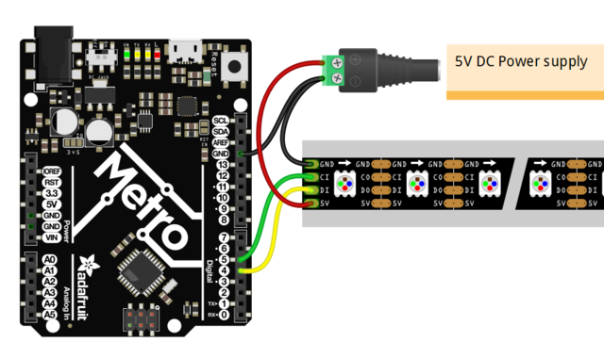
4.- OTHER LED STRIPS
Adafruit DOTSTAR LEDs.
It is another type of LED strip it can be controled by Arduino. The more important difference is you need 2 digital pins to control the strip.
https://learn.adafruit.com/adafruit-dotstar-leds?view=all
Source: https://www.adafruit.com

Slide 30
5.- LOOK AT THE VIDEOS
Here you can find some videos using LED strips, using different ways to program Arduino. Video 3 is a good descripcion of different LED strips.
Video 1: 7:36 min https://www.youtube.com/watch?v=rPvGLSuMaLA
Video 2: 9:31 min https://www.youtube.com/watch?v=UhYu0k2woRM
Video 3: 14:41 min https://www.youtube.com/watch?v=QnvircC22hU

Slide 31
email@aidimme.es

