Slide 1
SMARTRAIN
Introduction to Arduino platform

Slide 2
INDEX
1.- Introduction
5.- Program structure
2.- Board types
6.- Data types
3.- Arduino Uno description
7.- More resources
4.- IDE Instlallation
8.- Look at the videos

Slide 3
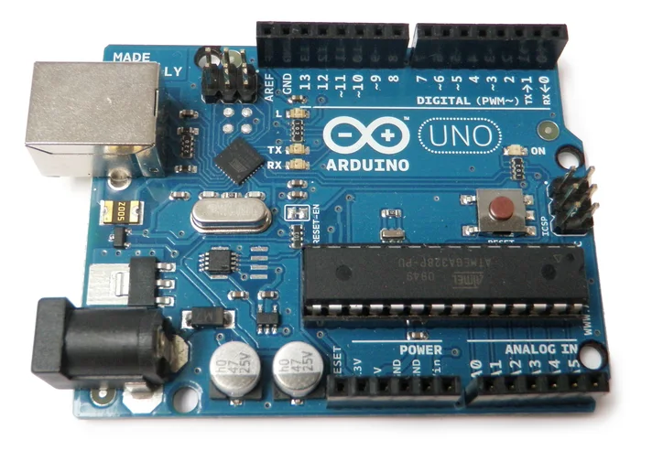
1.- INTRODUCTION
Arduino is an open-source electronics platform based on easy-to-use hardware and software. Arduino boards are able to read inputs - light on a sensor, a finger on a button, or a Twitter message - and turn it into an output - activating a motor, turning on an LED, publishing something online. You can tell your board what to do by sending a set of instructions to the microcontroller on the board. To do so you use the Arduino programming language (based on Wiring), and the Arduino Software (IDE), based on Processing.
Arduino UNO board. Source: https://www.instructables.com/Intro-to-Arduino/

Slide 4
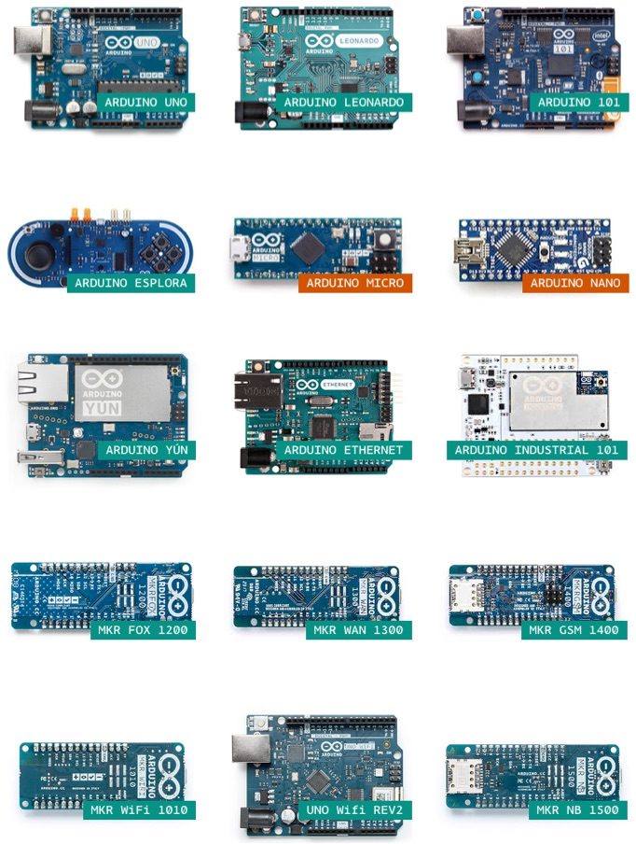
2.- BOARD TYPES
Various kinds of Arduino boards are available depending on different microcontrollers used. However, all Arduino boards have one thing in common: they are programed through the Arduino IDE.
The differences are based on the number of inputs and outputs (the number of sensors, LEDs, and buttons you can use on a single board), speed, operating voltage, form factor etc. Some boards are designed to be embedded and have no programming interface (hardware), which you would need to buy separately. Some can run directly from a 3.7V battery, others need at least 5V.
Different Arduino’s board. Source: https://www.xataka.com/

Slide 5
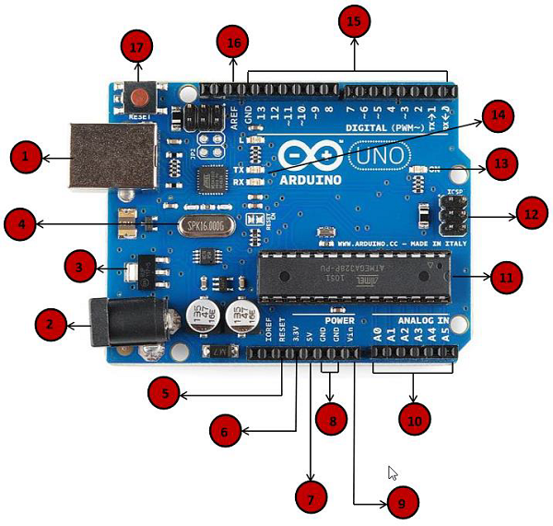
3.- ARDUINO UNO DESCRIPTION
We will study the Arduino UNO board because it is the most popular board in the Arduino board family. In addition, it is the best board to get started with electronics and coding. Some boards look a bit different from the one given below, but most Arduinos have majority of these components in common.
Arduino UNO board. Source: https://www.tutorialspoint.com/arduino

Slide 6
3.- ARDUINO UNO DESCRIPTION
1. Power USB
Arduino board can be powered by using the USB cable from your computer. All you need to do is connect the USB cable to the USB connection (1).
2. Power (Barrel Jack)
Arduino boards can be powered directly from the AC mains power supply by connecting it to the Barrel Jack (2).
3. Voltage Regulator
The function of the voltage regulator is to control the voltage given to the Arduino board and stabilize the DC voltages used by the processor and other elements
4. Crystal Oscillator
The crystal oscillator helps Arduino in dealing with time issues. How does Arduino calculate time? The answer is, by using the crystal oscillator. The number printed on top of the Arduino crystal is 16.000H9H. It tells us that the frequency is 16,000,000 Hertz or 16 MHz
5 / 17. Arduino Reset
You can reset your Arduino board, i.e., start your program from the beginning. You can reset the UNO board in two ways. First, by using the reset button (17) on the board. Second, you can connect an external reset button to the Arduino pin labelled RESET (5).

Slide 7
3.- ARDUINO UNO DESCRIPTION
6 / 7 / 8 / 9. Pins (3.3, 5, GND, Vin)
3.3V (6) − Supply 3.3 output volt
5V (7) − Supply 5 output volt
Most of the components used with Arduino board works fine with 3.3 volt and 5 volt.
GND (8)(Ground) − There are several GND pins on the Arduino, any of which can be used to ground your circuit.
Vin (9) − This pin also can be used to power the Arduino board from an external power source, like AC mains power supply.
10. Analog pins
The Arduino UNO board has six analog input pins A0 through A5. These pins can read the signal from an analog sensor like the humidity sensor or temperature sensor and convert it into a digital value that can be read by the microprocessor.
11. Main microcontroller
Each Arduino board has its own microcontroller (11). You can assume it as the brain of your board. The main IC (integrated circuit) on the Arduino is slightly different from board to board. The microcontrollers are usually of the ATMEL Company. You must know what IC your board has before loading up a new program from the Arduino IDE. This information is available on the top of the IC. For more details about the IC construction and functions, you can refer to the data sheet.

Slide 8
3.- ARDUINO UNO DESCRIPTION
12. ICSP pin
Mostly, ICSP (12) is an AVR, a tiny programming header for the Arduino consisting of MOSI, MISO, SCK, RESET, VCC, and GND. It is often referred to as an SPI (Serial Peripheral Interface), which could be considered as an "expansion" of the output. Actually, you are slaving the output device to the master of the SPI bus.
13. Power LED indicator
This LED should light up when you plug your Arduino into a power source to indicate that your board is powered up correctly. If this light does not turn on, then there is something wrong with the connection.
14. TX and RX LEDs
On your board, you will find two labels: TX (transmit) and RX (receive). They appear in two places on the Arduino UNO board. First, at the digital pins 0 and 1, to indicate the pins responsible for serial communication. Second, the TX and RX led (13). The TX led flashes with different speed while sending the serial data. The speed of flashing depends on the baud rate used by the board. RX flashes during the receiving process.
15. Digital I/O
The Arduino UNO board has 14 digital I/O pins (15) (of which 6 provide PWM (Pulse Width Modulation) output. These pins can be configured to work as input digital pins to read logic values (0 or 1) or as digital output pins to drive different modules like LEDs, relays, etc. The pins labeled “~” can be used to generate PWM.

Slide 9
3.- ARDUINO UNO DESCRIPTION
16. AREF
AREF stands for Analog Reference. It is sometimes, used to set an external reference voltage (between 0 and 5 Volts) as the upper limit for the analog input pins.

Slide 10
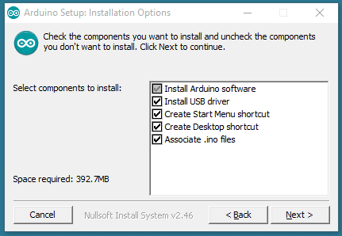
4.- IDE INSTALLATION
Download the Arduino Software (IDE)
Get the latest version from the download page. You can choose between the Installer (.exe) and the Zip packages. We suggest you use the first one that installs directly everything you need to use the Arduino Software (IDE), including the drivers. With the Zip package you need to install the drivers manually. The Zip file is also useful if you want to create a portable installation.
When the download finishes, proceed with the installation and please allow the driver installation process when you get a warning from the operating system.
Arduino IDE installation. Source: https://www.arduino.cc/en/Guide/Windows

Slide 11
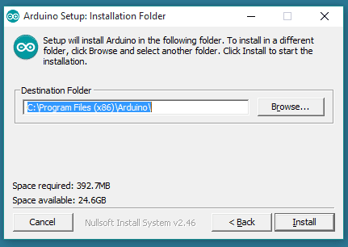
4.- IDE INSTALLATION
Choose the components to install
Arduino IDE installation. Source: https://www.arduino.cc/en/Guide/Windows
Choose the installation directory (we suggest to keep the default one)

Slide 12
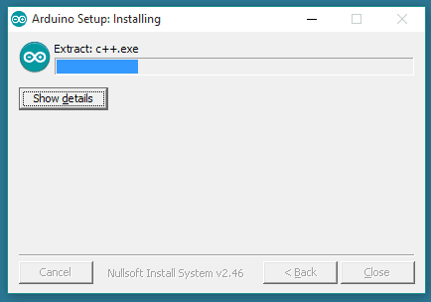
4.- IDE INSTALLATION
Arduino IDE installation. Source: https://www.arduino.cc/en/Guide/Windows
The process will extract and install all the required files to execute properly the Arduino Software (IDE)

Slide 13
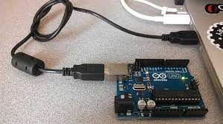
4.- IDE INSTALLATION
First running
First you must have your Arduino board (you can choose your favorite board) and a USB cable. In case you use Arduino UNO, Arduino Duemilanove, Nano, Arduino Mega 2560, or Diecimila, you will need a standard USB cable (A plug to B plug), the kind you would connect to a USB printer as shown in the following image.
Arduino programing wire. Source: https://www.brecogeek.com

Slide 14
4.- IDE INSTALLATION
Power up your board.
The Arduino Uno, Mega, Duemilanove and Arduino Nano automatically draw power from either, the USB connection to the computer or an external power supply. If you are using an Arduino Diecimila, you have to make sure that the board is configured to draw power from the USB connection. The power source is selected with a jumper, a small piece of plastic that fits onto two of the three pins between the USB and power jacks. Check that it is on the two pins closest to the USB port.
Connect the Arduino board to your computer using the USB cable. The green power LED (labeled PWR) should glow.

Slide 15
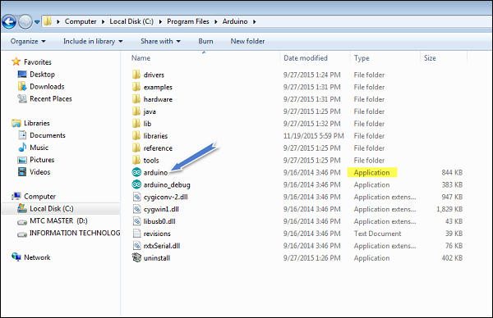
4.- IDE INSTALLATION
Launch Arduino IDE.
After your Arduino IDE software is downloaded, you need to unzip the folder. Inside the folder, you can find the application icon with an infinity label (application.exe). Double-click the icon to start the IDE.
Arduino programing wire. Source: https://www.tutorialspoint.com/arduino/arduino_installation.htm

Slide 16
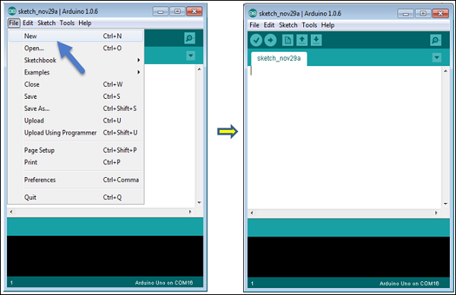
4.- IDE INSTALLATION
Open your first project.
Once the software starts, you have two options:
- Create a new project.
- Open an existing project example.
To create a new project, select File → New.
Arduino programing wire. Source: https://www.tutorialspoint.com/arduino/arduino_installation.htm

Slide 17
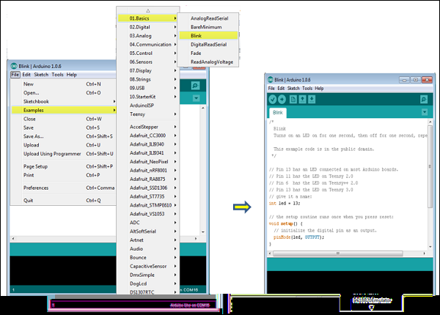
4.- IDE INSTALLATION
Open your first project.
To open an existing project example, select File → Example → Basics → Blink.
Arduino programing wire. Source: https://www.tutorialspoint.com/arduino/arduino_installation.htm

Slide 18
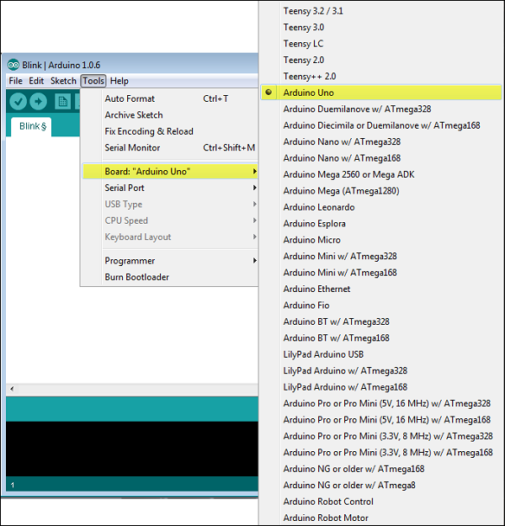
4.- IDE INSTALLATION
Select your Arduino board.
To avoid any error while uploading your program to the board, you must select the correct Arduino board name, which matches with the board connected to your computer.
Go to Tools → Board and select your board.
Arduino programing wire. Source: https://www.tutorialspoint.com/arduino/arduino_installation.htm

Slide 19
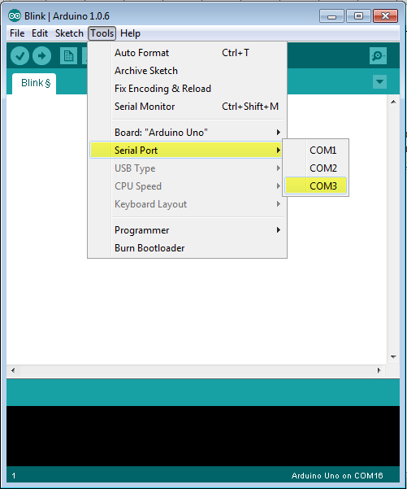
4.- IDE INSTALLATION
Select your serial port.
Select the serial device of the Arduino board. Go to Tools → Serial Port menu. This is likely to be COM3 or higher (COM1 and COM2 are usually reserved for hardware serial ports). To find out, you can disconnect your Arduino board and re-open the menu, the entry that disappears should be of the Arduino board. Reconnect the board and select that serial port.
Arduino programing wire. Source: https://www.tutorialspoint.com/arduino/arduino_installation.htm

Slide 20
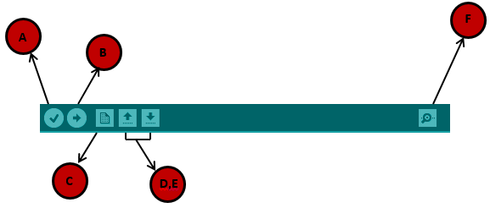
4.- IDE INSTALLATION
Upload the program to your board.
Before explaining how we can upload our program to the board, we must demonstrate the function of each symbol appearing in the Arduino IDE toolbar.
A − Used to check if there is any compilation error.
B − Used to upload a program to the Arduino board.
C − Shortcut used to create a new sketch.
D − Used to directly open one of the example sketch.
E − Used to save your sketch.
F − Serial monitor used to receive serial data from the board and send the serial data to the board.
Arduino programing wire. Source: https://www.tutorialspoint.com/arduino/arduino_installation.htm
Now, simply click the "Upload" button in the environment. Wait a few seconds; you will see the RX and TX LEDs on the board, flashing. If the upload is successful, the message "Done uploading" will appear in the status bar

Slide 21
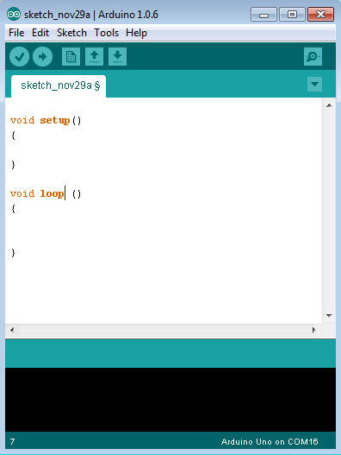
5.- PROGRAM STRUCTURE
Arduino programs can be divided in three main parts: Structure, Values (variables and constants), and Functions. In this tutorial, we will learn about the Arduino software program, step by step, and how we can write the program without any syntax or compilation error.
Let us start with the Structure. Software structure consist of two main functions:
Setup( ) function
Loop( ) function
Program structure.
Source: https://www.tutorialspoint.com/arduino/arduino_installation.htm

Slide 22
5.- PROGRAM STRUCTURE
The setup() function is called when a sketch starts. Use it to initialize the variables, pin modes, start using libraries, etc. The setup function will only run once, after each power up or reset of the Arduino board.
After creating a setup() function, which initializes and sets the initial values, the loop() function does precisely what its name suggests, and loops consecutively, allowing your program to change and respond. Use it to actively control the Arduino board.

Slide 23
6.- DATA TYPES
Below is a list of the data types commonly seen in Arduino, with the memory size of each in parentheses after the type name. Note: signed variables allow both positive and negative numbers, while unsigned variables allow only positive values.
boolean (8 bit) - simple logical true/false
byte (8 bit) - unsigned number from 0-255
char (8 bit) - signed number from -128 to 127. The compiler will attempt to interpret this data type as a character in some circumstances, which may yield unexpected results
unsigned char (8 bit) - same as 'byte'; if this is what you're after, you should use 'byte' instead, for reasons of clarity
word (16 bit) - unsigned number from 0-65535
unsigned int (16 bit)- the same as 'word'. Use 'word' instead for clarity and brevity

Slide 24
6.- DATA TYPES
int (16 bit) - signed number from -32768 to 32767. This is most commonly what you see used for general purpose variables in Arduino example code provided with the IDE
unsigned long (32 bit) - unsigned number from 0-4,294,967,295. The most common usage of this is to store the result of the millis() function, which returns the number of milliseconds the current code has been running
long (32 bit) - signed number from -2,147,483,648 to 2,147,483,647
float (32 bit) - signed number from -3.4028235E38 to 3.4028235E38. Floating point on the Arduino is not native; the compiler has to jump through hoops to make it work. If you can avoid it, you should. We'll touch on this later.

Slide 25
7.- MORE RESOURCES
Here you can find more online tutorials to learn how to program the arduino board:
https://www.arduino.cc/en/Tutorial/HomePage
https://www.tutorialspoint.com/arduino/index.htm
https://www.programmingelectronics.com/tutorial-3-arduino-ide-and-sketch-overview/

Slide 26
8.- LOOK AT THE VIDEOS
Here you can find some videos about how to use Arduino.
Video 1:
https://www.youtube.com/watch?v=09zfRaLEasY
Video 2:
https://www.youtube.com/watch?v=w55Pd4dU5-w
https://www.youtube.com/watch?v=YDkdVZ7e3OY&list=PLYutciIGBqC34bfijBdYch49oyU-B_ttH&index=5
Video 3:
https://www.youtube.com/watch?v=AJkEQ9t4WfY&list=PLYutciIGBqC34bfijBdYch49oyU-B_ttH&index=6
Video 4:

Slide 27
email@aidimme.es

