Slide 1
SMARTRAIN
Arduino’s Examples

Slide 2
EXAMPLE 1

Slide 3

1.- Example 1
User
Temperature
Arduino
Mobile phone
Humidity
Gas
Comunication system
¿Sensors?
App

Slide 4
1.- Example 1
Sensors
Temperature & Humidity ➔ See “Measuring temperature & humidity”
Gas ➔ See “Measuring Gas”
…
But there are other possibilities:
https://www.bluedot.space/products/bme680/
https://www.adafruit.com/category/897

Slide 5
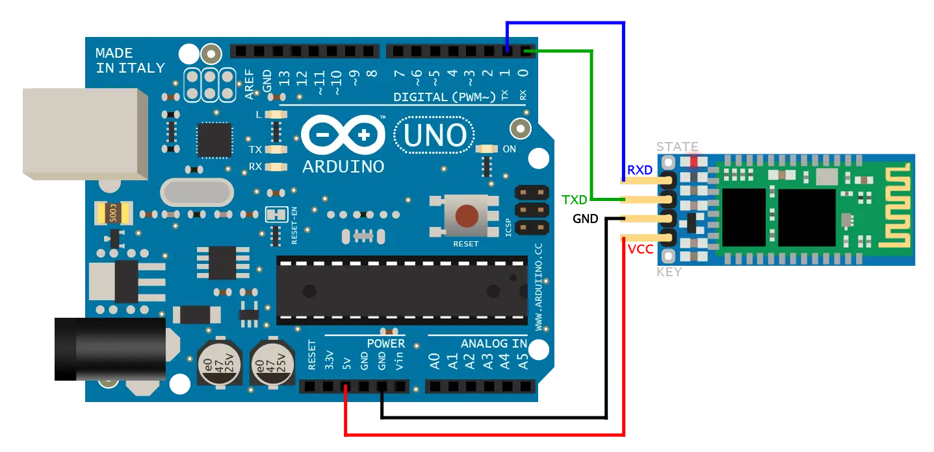
1.- Example 1
Comunication system
Bluetooth system ➔
https://create.arduino.cc/projecthub/electropeak/getting-started-with-hc-05-bluetooth-module-arduino-e0ca81
https://howtomechatronics.com/tutorials/arduino/arduino-and-hc-05-bluetooth-module-tutorial/

Slide 6
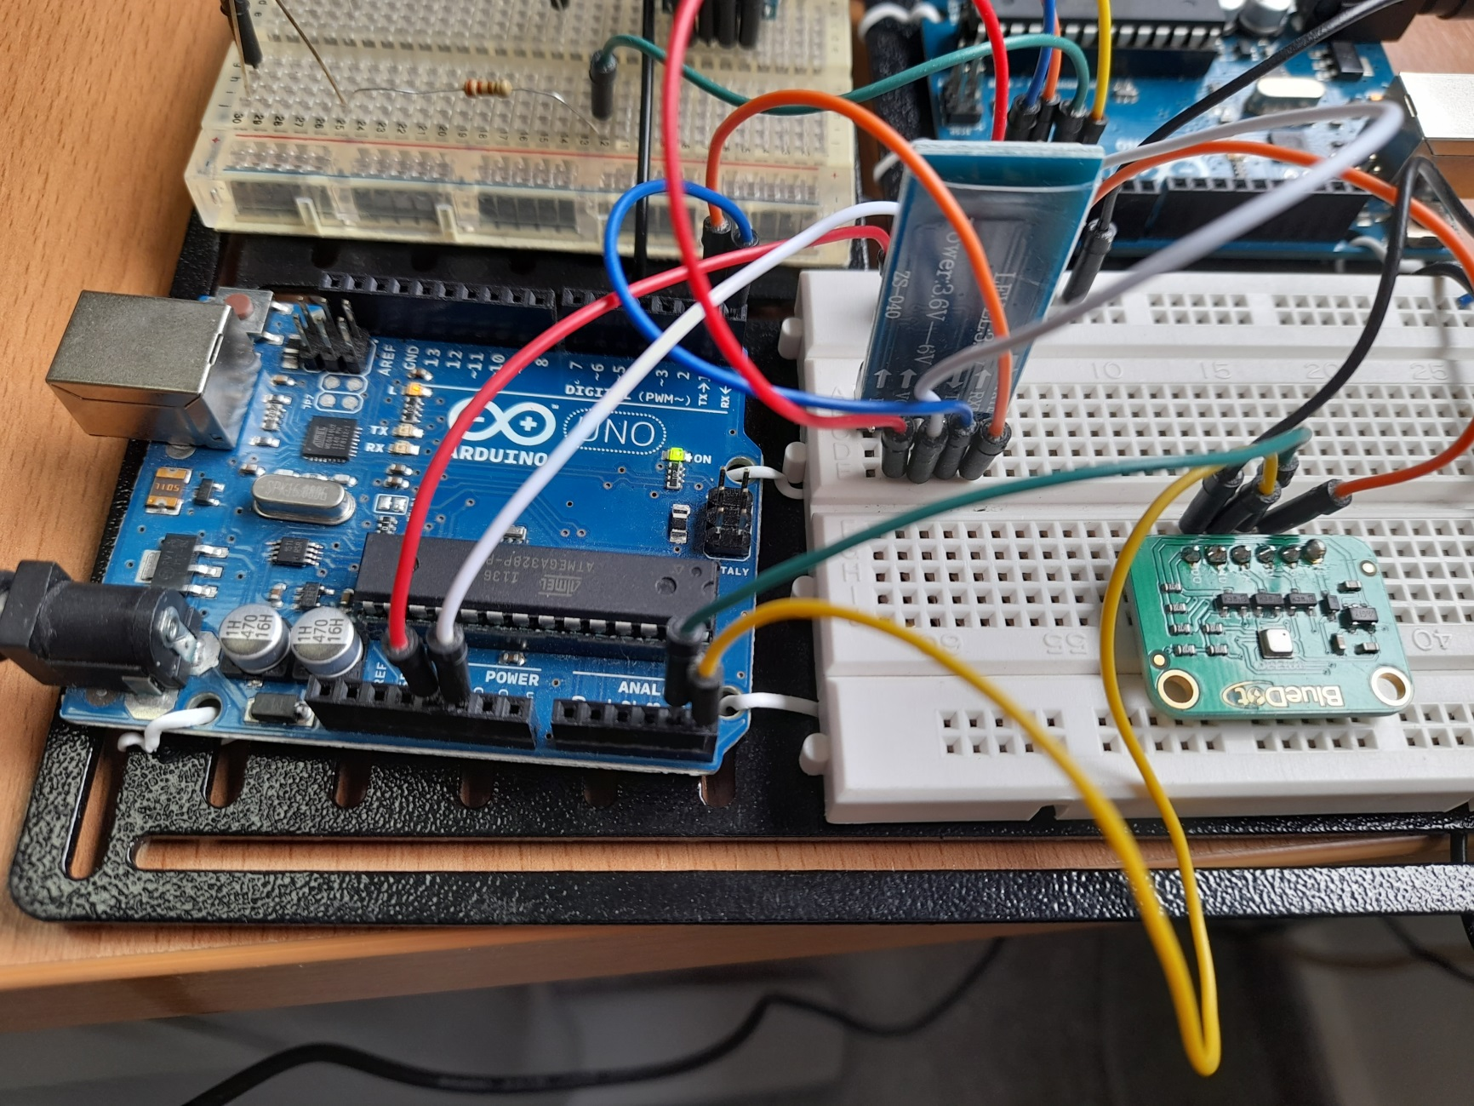
1.- Example 1
Wire conexion

Slide 7
1.- Example 1
Arduino Code
#include <SPI.h>
#include <Adafruit_Sensor.h>
#include "Adafruit_BME680.h"
#define BME_SCK 13
#define BME_MISO 12
#define BME_MOSI 11
#define BME_CS 10
#define SEALEVELPRESSURE_HPA (1013.25)
Adafruit_BME680 bme; // I2C
//Adafruit_BME680 bme(BME_CS); // hardware SPI
//Adafruit_BME680 bme(BME_CS, BME_MOSI, BME_MISO, BME_SCK);
void setup() {
Serial.begin(9600);
while (!Serial);
Serial.println(F("BME680 test"));
if (!bme.begin()) {
Serial.println("Could not find a valid BME680 sensor, check wiring!");
while (1);
}
// Set up oversampling and filter initialization
bme.setTemperatureOversampling(BME680_OS_8X);
bme.setHumidityOversampling(BME680_OS_2X);
bme.setPressureOversampling(BME680_OS_4X);
bme.setIIRFilterSize(BME680_FILTER_SIZE_3);
bme.setGasHeater(320, 150); // 320*C for 150 ms
}
void loop() {
if (! bme.performReading()) {
Serial.println("Failed to perform reading :(");
return;
}
Serial.print(int(bme.temperature));
Serial.print(";");
Serial.print(int(bme.humidity));
Serial.print(";");
Serial.print(int(bme.pressure / 100.0));
Serial.print(";");
Serial.print(int(bme.readAltitude(SEALEVELPRESSURE_HPA)));
Serial.print(";");
Serial.print(int(bme.gas_resistance / 1000.0));
Serial.print("\n"); // Fin de línea. Importante.
delay(5000);
}

Slide 8
EXAMPLE 2

Slide 9
1.- Example 2
User
Arduino
Mobile phone
Ligths
Comunication system
¿Actuators?
App

Slide 10
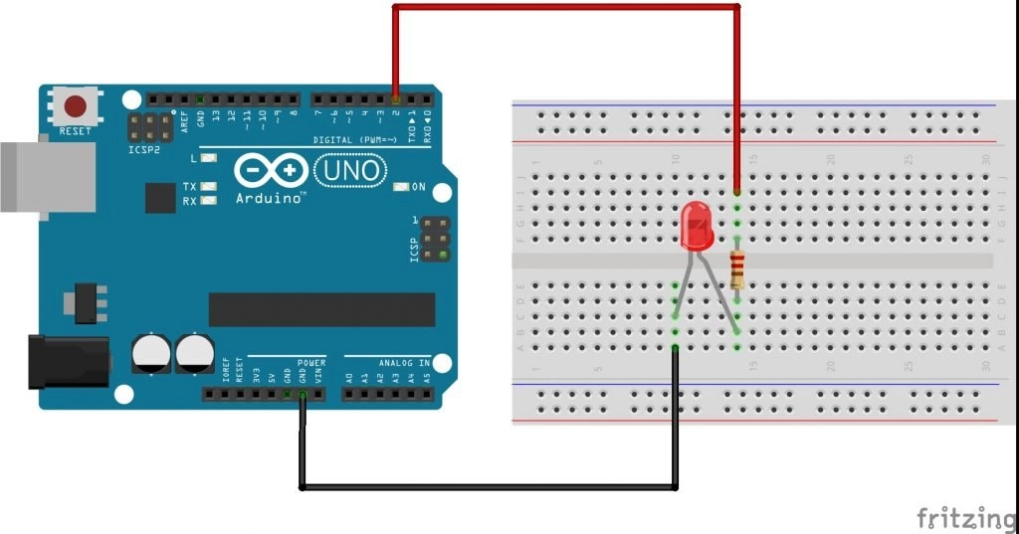
1.- Example 2
Actuators
Diode Led➔ See…
https://create.arduino.cc/projecthub/karmette/basic-led-setup-for-beginners-0a124a
https://www.circuitbasics.com/arduino-basics-controlling-led/
Led strip ➔ See “Using Led strips”

Slide 11
1.- Example 2
Comunication system
Bluetooth system ➔
The same than example 1

Slide 12
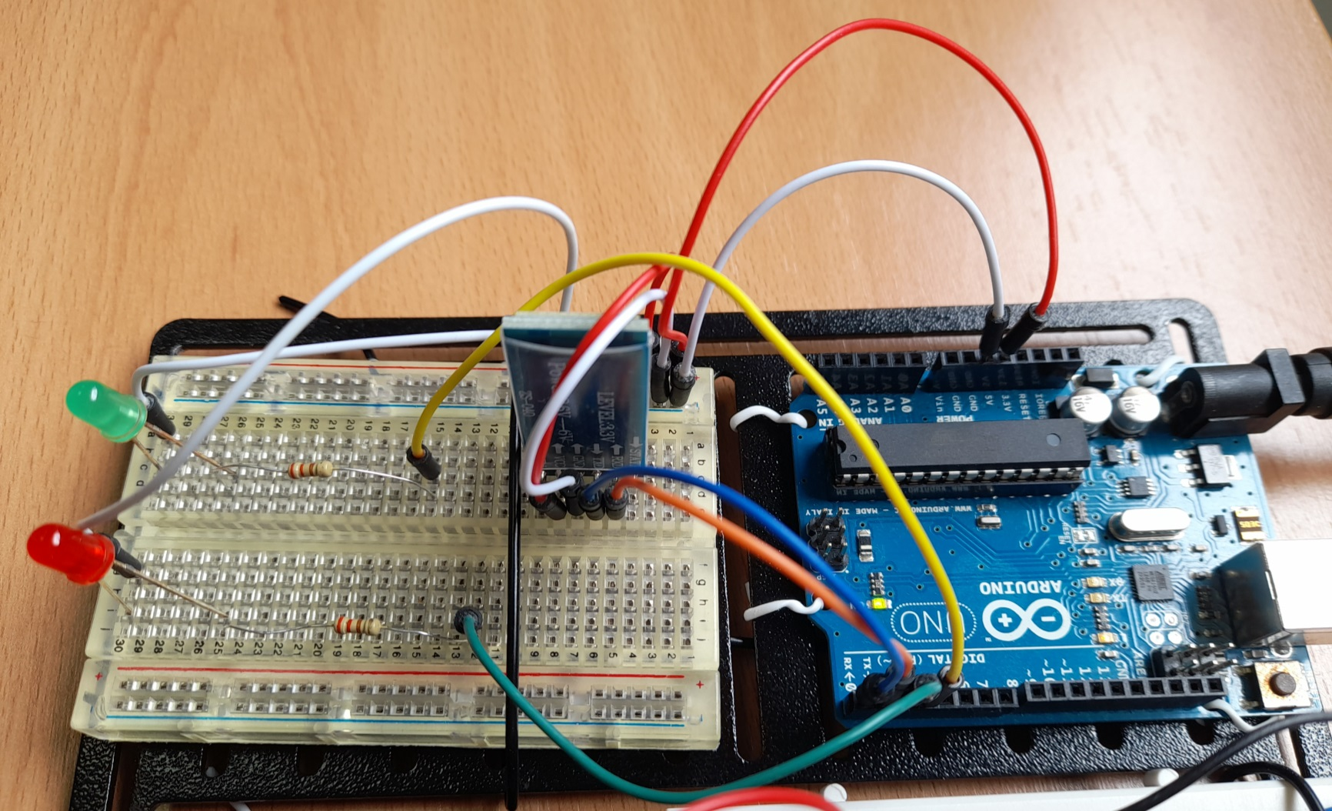
1.- Example 1
Wire conexion

Slide 13
1.- Example 1
Arduino Code
//Variables asociadas a los dos LEDs que se van a controlar
int led_1 = 2;
int led_2 = 3;
char valor; //Variable para indicar que llega una orden
void setup() {
pinMode(led_1, OUTPUT);
pinMode(led_2, OUTPUT);
Serial.begin(9600);
}
void loop() {
//Serial.println("prueba");
if (Serial.available()) //Si el puerto serie (Bluetooth) está disponible
{
valor = Serial.read(); //Lee el dato entrante via Bluetooth
Serial.print("Dato recibido: ");
Serial.println(valor);
if (valor == 'A') //Si el dato que llega es una A
{
digitalWrite(led_1, HIGH); //Enciende el LED 1
}
if (valor == 'B') //Si el dato que llega es una B
{
digitalWrite(led_1, LOW); //Apaga el LED 1
}
if (valor == 'C') //Si el dato que llega es una C/
{
digitalWrite(led_2, HIGH); //Enciende el LED 2
}
if (valor == 'D') //Si el dato que llega es una D
{
digitalWrite(led_2, LOW); //Apaga el LED 2
}
}
}

Slide 14
email@aidimme.es

