Slide 1
Overview of Android development with MIT App Inventor
03 / May / 2022

Slide 2

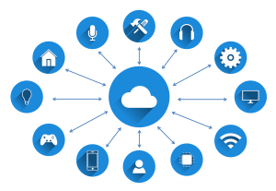

1.- Motivation
The main objective for this short overview is to provide an overall vision on how Android APPs can be implemented by users with no high technical background through user-friendly environments.
App Inventor by MIT is presented as reference development environment
Internet Of Things (IoT) is the concept of connecting devices to the Internet and to other connected devices. This can be considered as a huge network of connected things and people collecting and sharing data about themselves and the environment around them.
In this overview, focus is on the development of mobile APPs in a IoT environment through a simple example to manage LEDs and monitor ambient parameters via Bluetooth.
REFERENCES:
https://www.ibm.com/blogs/internet-of-things/what-is-the-iot/

Slide 3
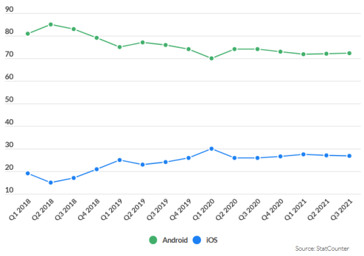
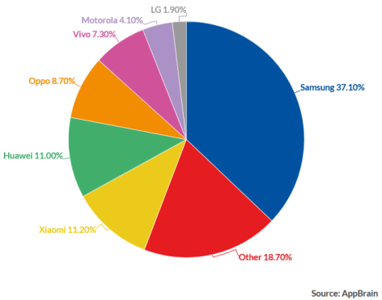


2.- Current rise of Android/iOS Applications
The social need of being often connected has leaded to the normalization of use of personal mobile devices such as smartphones and tablets.
Therefore, the use of mobile APPs has highly increased
Mobile APPs often replaces larger devices for performing specific tasks (i.e.: email, social networks)
Actually almost every products aims at providing its own mobile APP
Android vs iOS global market share (%)
Android vendor market share in 2021 (%)
REFERENCES:
https://www.ibxagency.com/blog/el-auge-de-las-app-moviles/
https://www.businessofapps.com/data/android-statistics/

Slide 4
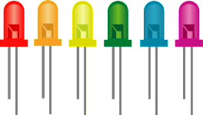


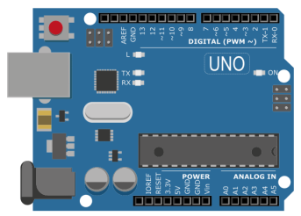





3.- The App Use Case
In this overview, focus is on the development of mobile APPs in a IoT environment through a simple example to manage LEDs and monitor ambient parameters via Bluetooth.
MOBILE APP
Colour LEDs
AMBIENT PARAMETERS
ARDUINO
Temperature
(Celsius)
Humidity
(%)
Pressure
(hPa)
Altitude
(meters)
Gas
(KOhms)

Slide 5
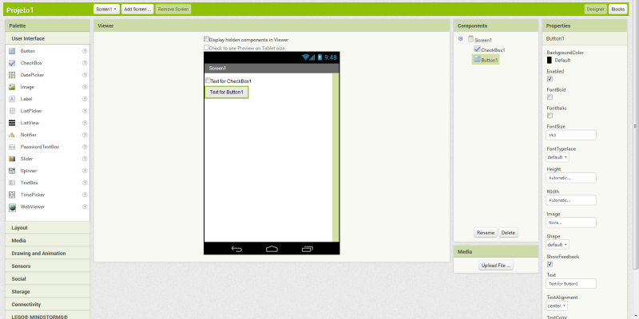
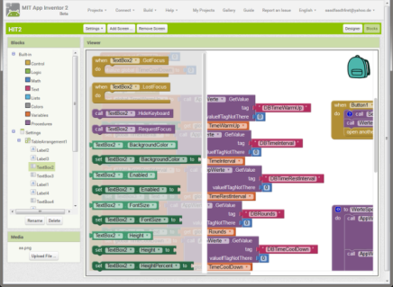

4.- MIT APP INVENTOR
Visual programming environment to build functional apps for Android/iOS devices, based on Blocks
Aims at “democratize software development by empowering all people” to move from technology consumption to technology creation
It provides a free online app development environment that serves more than 6 million registered users
REFERENCES:
https://appinventor.mit.edu/

Slide 6
5.- APP implementation with MIT App Inventor
…
LIVE:
http://ai2.appinventor.mit.edu/#4964674767814656

Slide 7
email@aidimme.es

